Slide 1
Typescript(Javascript) top-up

Slide 2
TS Features
The following features are used in the labs/examples
Destructuring
Spread Operator
Default Arguments

Slide 3
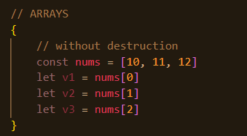
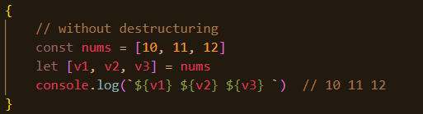
Destructuring
Assigning the properties of an array or object to variables using a declarative style rather than an imperative/procedural style.
See 01_destructing.ts

Slide 4
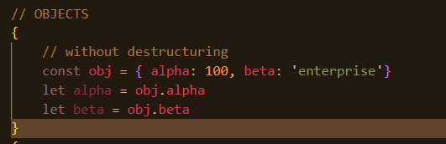
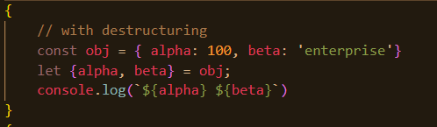
The Spread Operator
JS arrays and objects are iterables.
The spread operator allows an iterable to expand in places where 0+ arguments are expected.
Syntax:
…arrayRef …objectRef

Slide 5
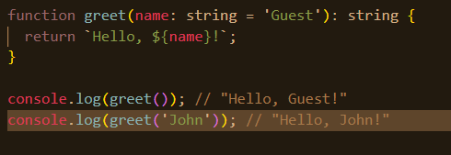
Default arguments

